Slide 1

Distributed Systems
Definition :
A system in which H/W and S/W components located at networked computers communicate and coordinate their actions only by passing messages.

Slide 2
Why Distributed System?
Sharing resources and ensuring availability of it.
E.g. :
1)Hardware like printer, camera, disk space, etc.
2)Information and Communication like databases, files, mobile phones, etc.
3)Media and Entertainment like music, video, etc.

Slide 3
Examples of Distributed Systems
Internet
Intranet
Mobile and Ubiquitous Systems

Slide 4
Internet
Large interconnected collection of computers
Interaction is via message passing
Various Protocols help with messages
  IP
  TCP
  UDP
  FTP
  HTTP

Slide 5
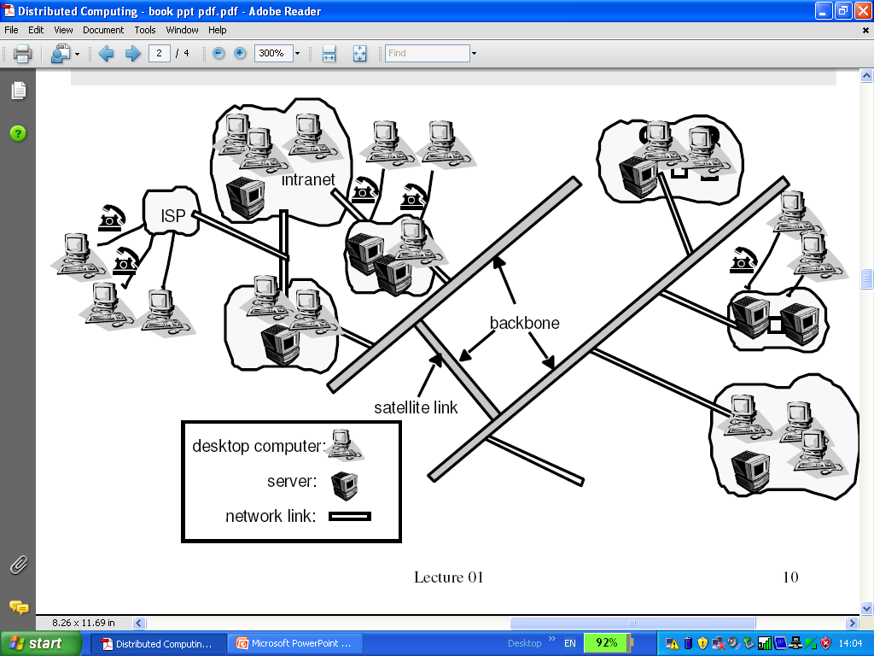
Internet

Slide 6
Intranet
Portion of the Internet that is separately administrated and has a boundary to configured to enforce local security policies.

Slide 7
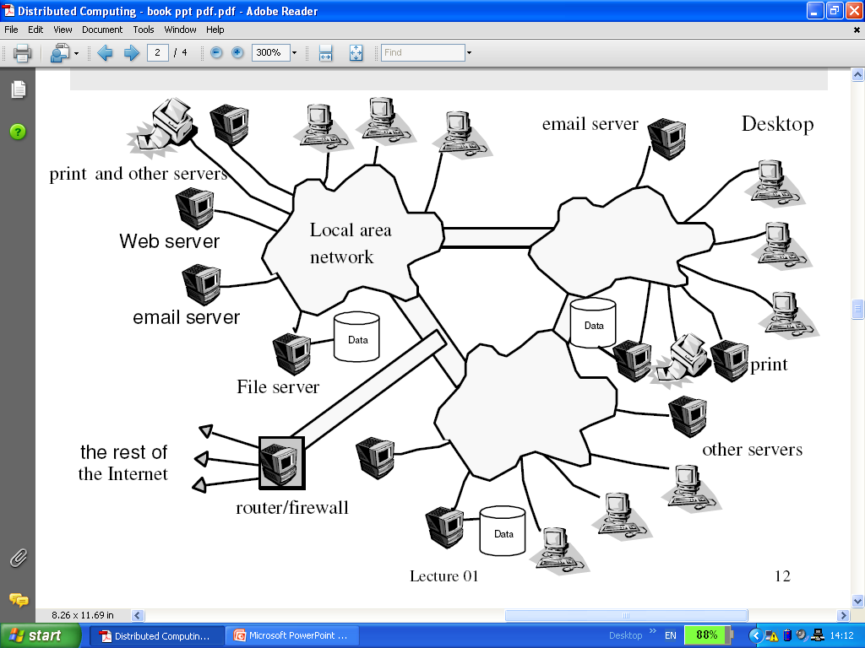
Intranet

Slide 8
Mobile and Ubiquitous computing
It is the harnessing of many small, cheap computational devices that are present in users’ physical environment.

Slide 9
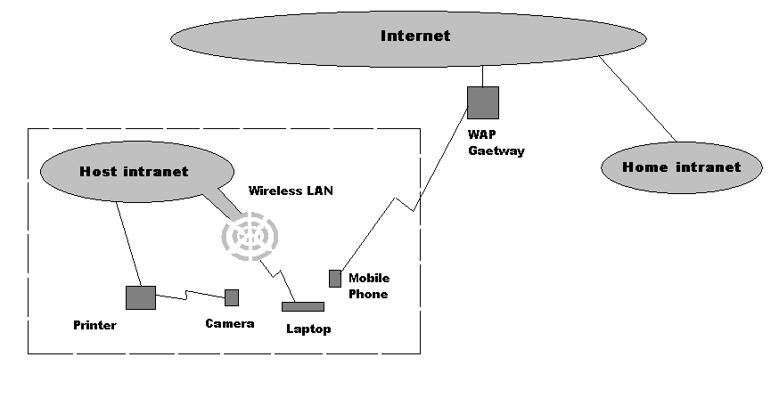
Mobile and Ubiquitous computing

Slide 10
Challenges of Distributed Systems
Heterogeneity
Openness
Security
Scalability
Failure handling
Concurrency
Transparency

Slide 11
Heterogeneity
System must work on different networks, hardware, OS, Programming Language and also implementation by different people.
It can be done by using proper standards.
Middleware – programming abstraction as well as masking the heterogeneity.
Like mobile code (Applets) and virtual machine.

Slide 12
Openness
Extensibility – The system can be extended and re-implemented in various ways.
It should allow new addition in system like,
New H/W – more computers,
S/W – support of new file format,
Services and
Sharing resources.
It can be done by publishing interfaces.

Slide 13
Security
Confidentiality – protection against disclosure to unauthorized individuals.
Integrity – protection against alteration and corruption.
Availability – protection against interference with the means to access the resources.

Slide 14
Scalability
Remain effective when there are significant increase in number of resources and users.
Controlling the cost of physical resources.
Controlling the performance loss.
Preventing resources from running out.
Avoid performance bottlenecks.

Slide 15
Failure Handling
Failure detection is partial and also difficult.
Detecting failure – few are impossible to detect.
Masking failure – retransmission
Tolerating failure
Recovery from failure – role back in DB (Transaction)
Redundancy – duplicate data

Slide 16
Concurrency
Services and resources are shared by the clients in a distributed systems.
Correct synchronization is essential.
e.g. Online Shopping

Slide 17
Transparency
Concealment of the distributed nature of system from user or programmer.
Access Transparency
Location Transparency
Concurrency Transparency
Replication Transparency
Failure Transparency
Mobility Transparency

